Slide 1
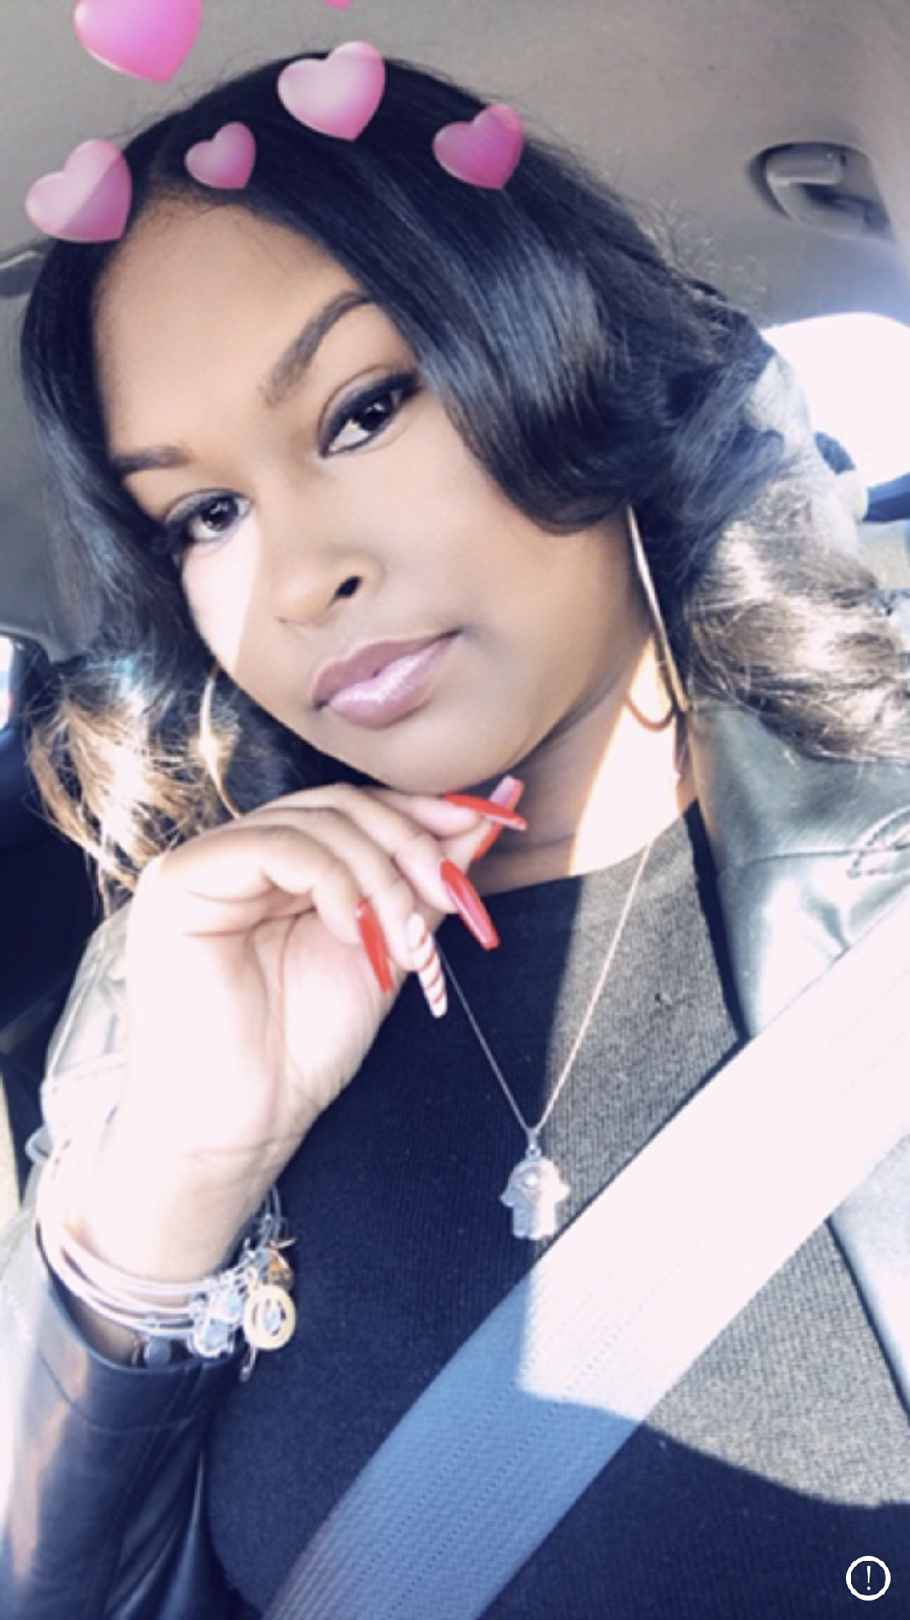
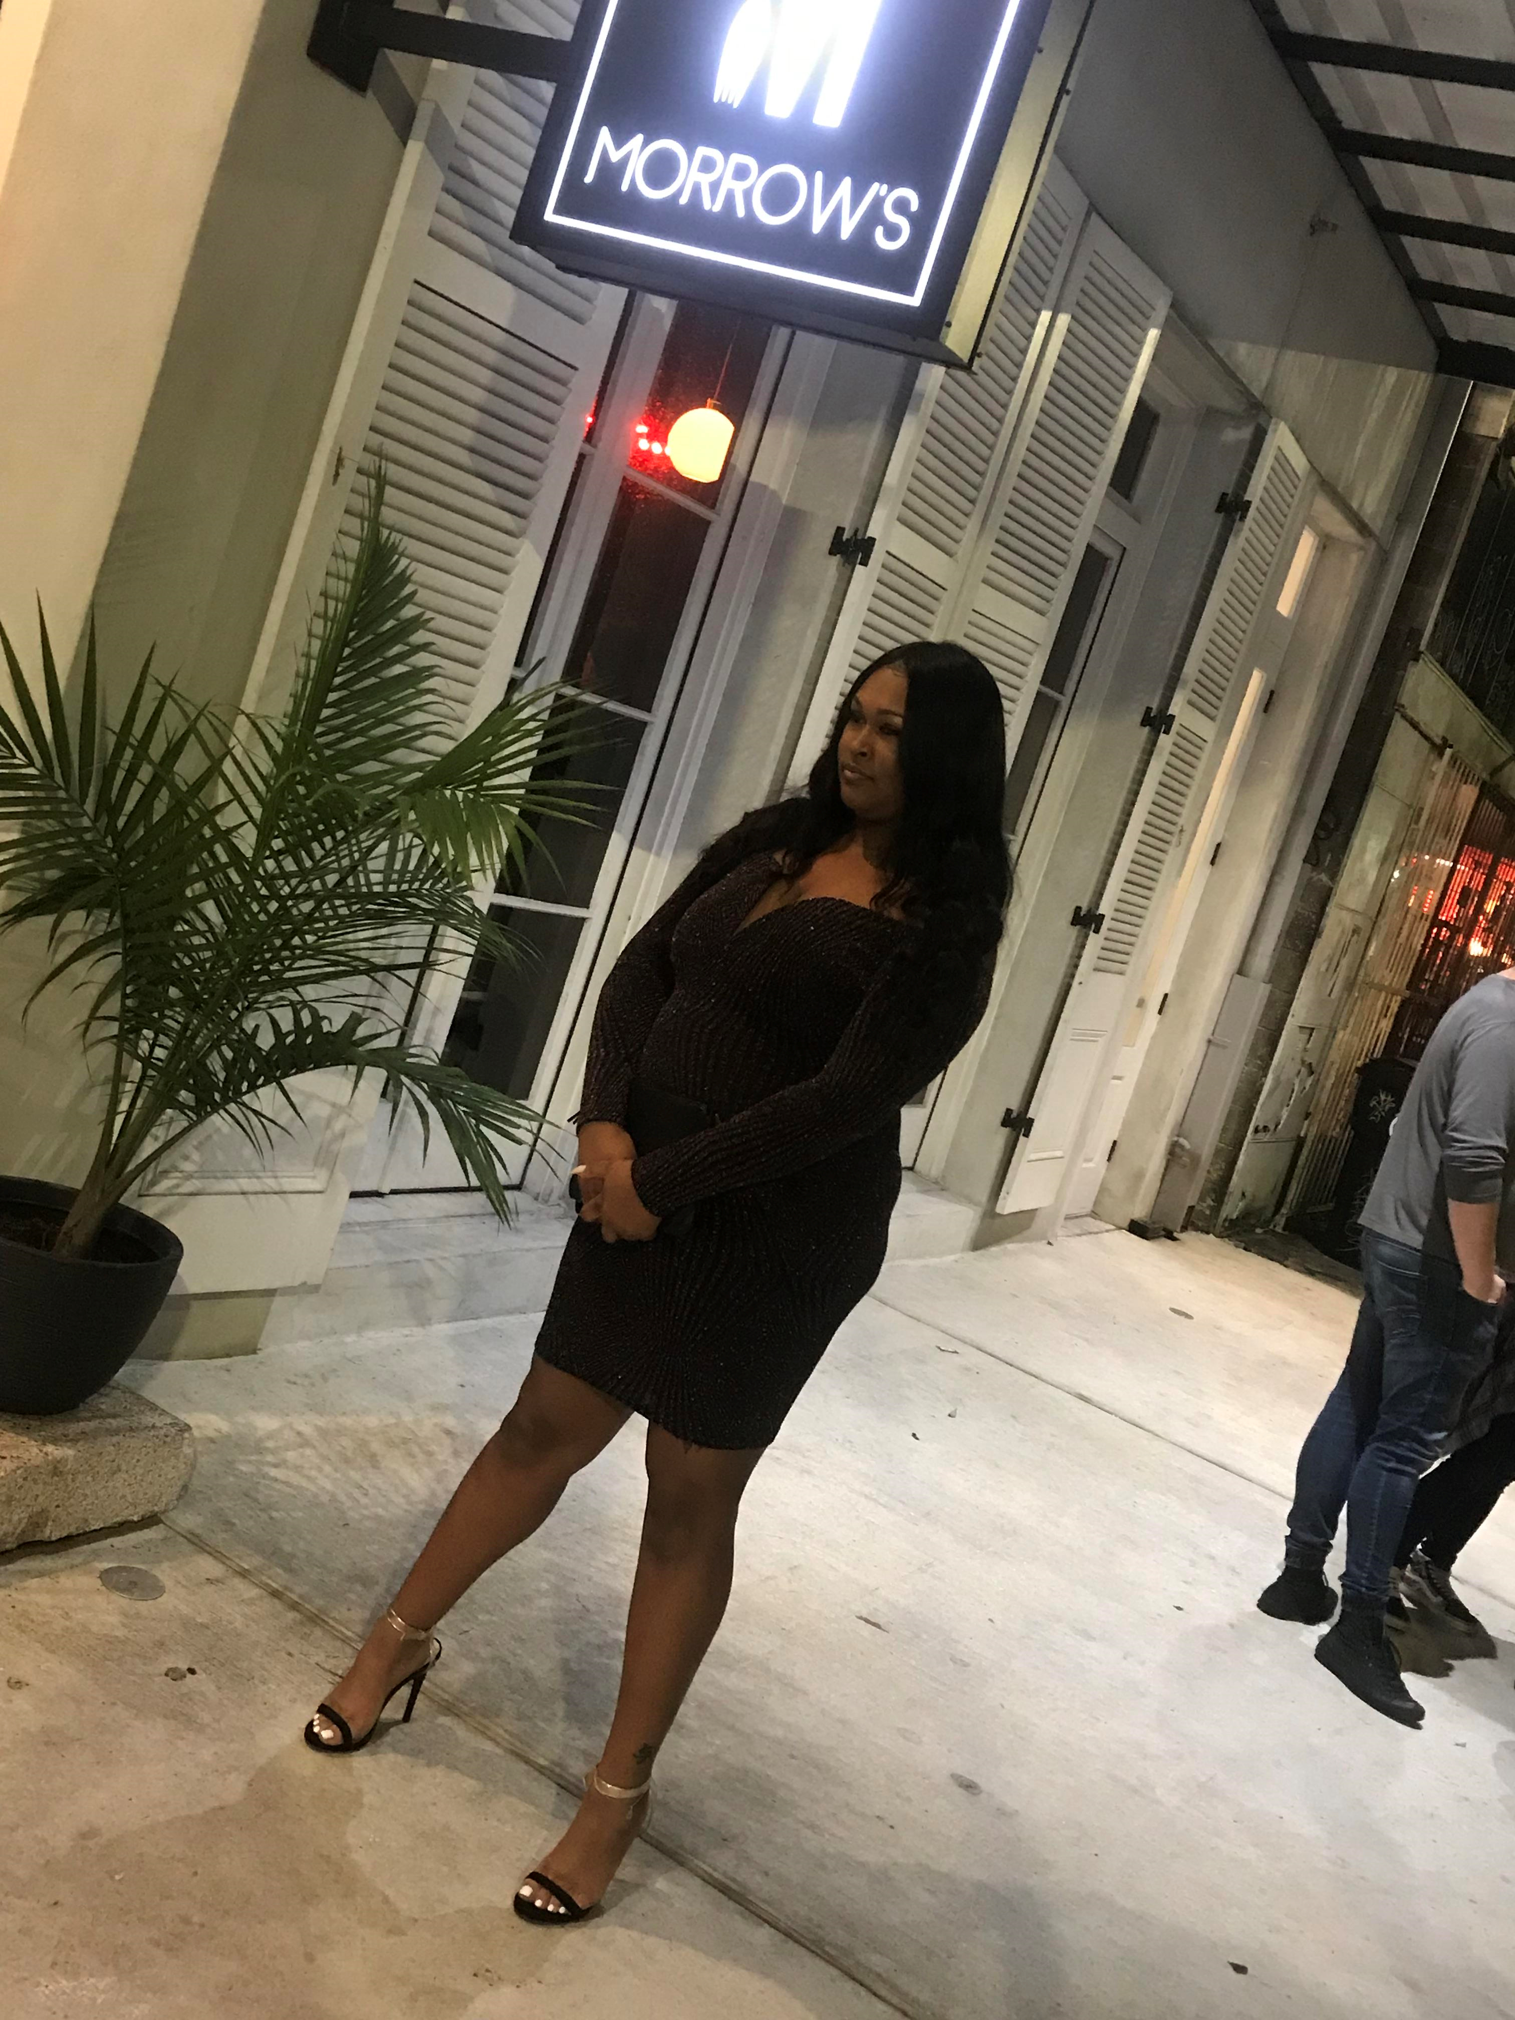
Getting to know Chenoa Bennett
Danc 102 SEC 001 Spring 19’

Slide 2


Major
I am a History major with a concentration in African American studies.
I also minor in Criminal Justice.

Slide 3



University Status
I am currently a graduating senior and expected to walk across the stage May 22nd 2019.
This Photo by Unknown Author is licensed under CC BY-NC-ND

Slide 4

Goals
My professional goal is to become a criminal defense attorney and help free wrongfully accused African Americans.
This Photo by Unknown Author is licensed under CC BY-SA-NC

Slide 5

Aspirations
I aspire to be great in all expects of life and touch as many individuals as I can.

Slide 6
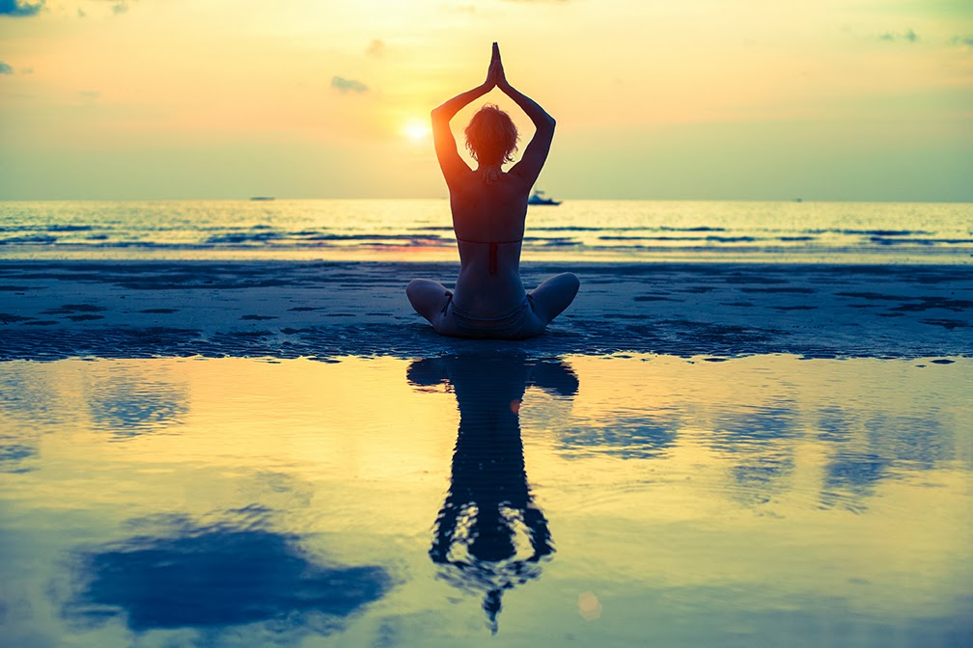
Why did you take yoga?
I decided to take yoga for two reasons:
This class will add valuable credits in order for me to graduate on time.
I consider myself to be an overthinker at times and I feel this course will help me clear my thoughts and channel my energy.
This Photo by Unknown Author is licensed under CC BY-NC-ND

